Slide 1
Legend
Not Fixed
Fixed
In Process
Could not recreate

Slide 2
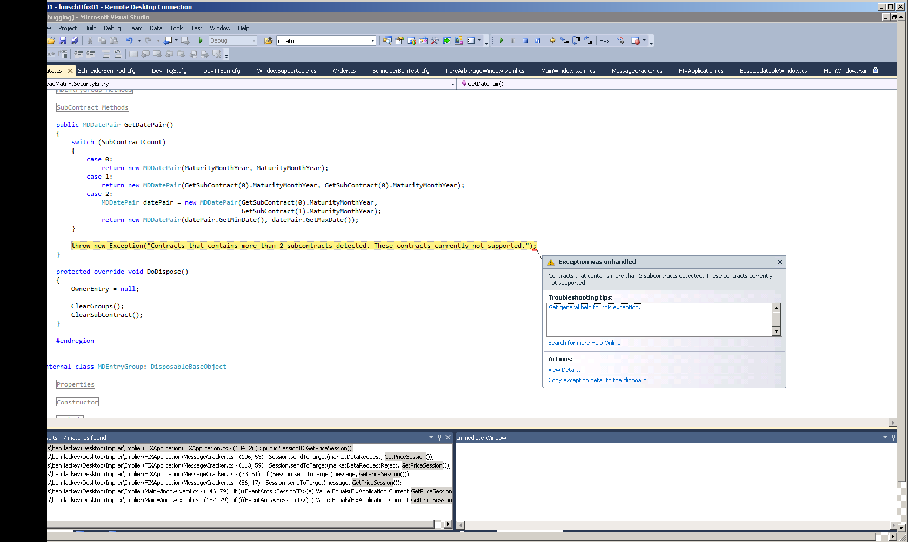
Fixed

Slide 3
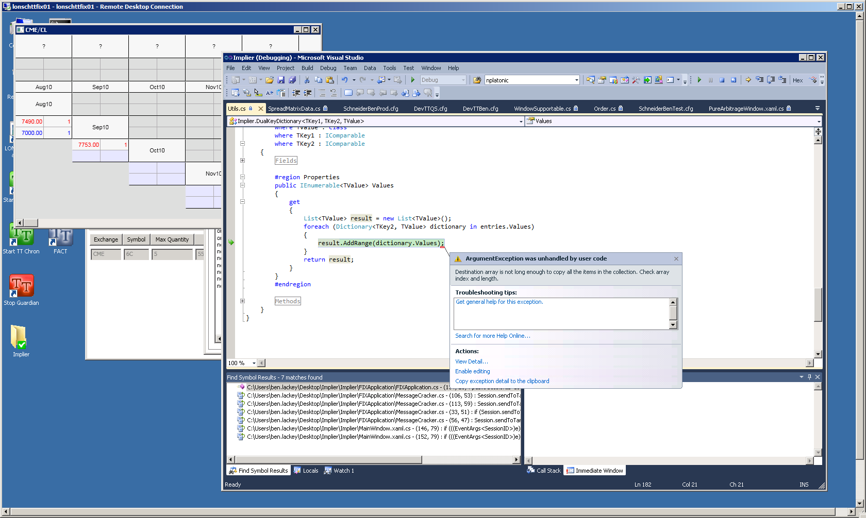
Fixed

Slide 4
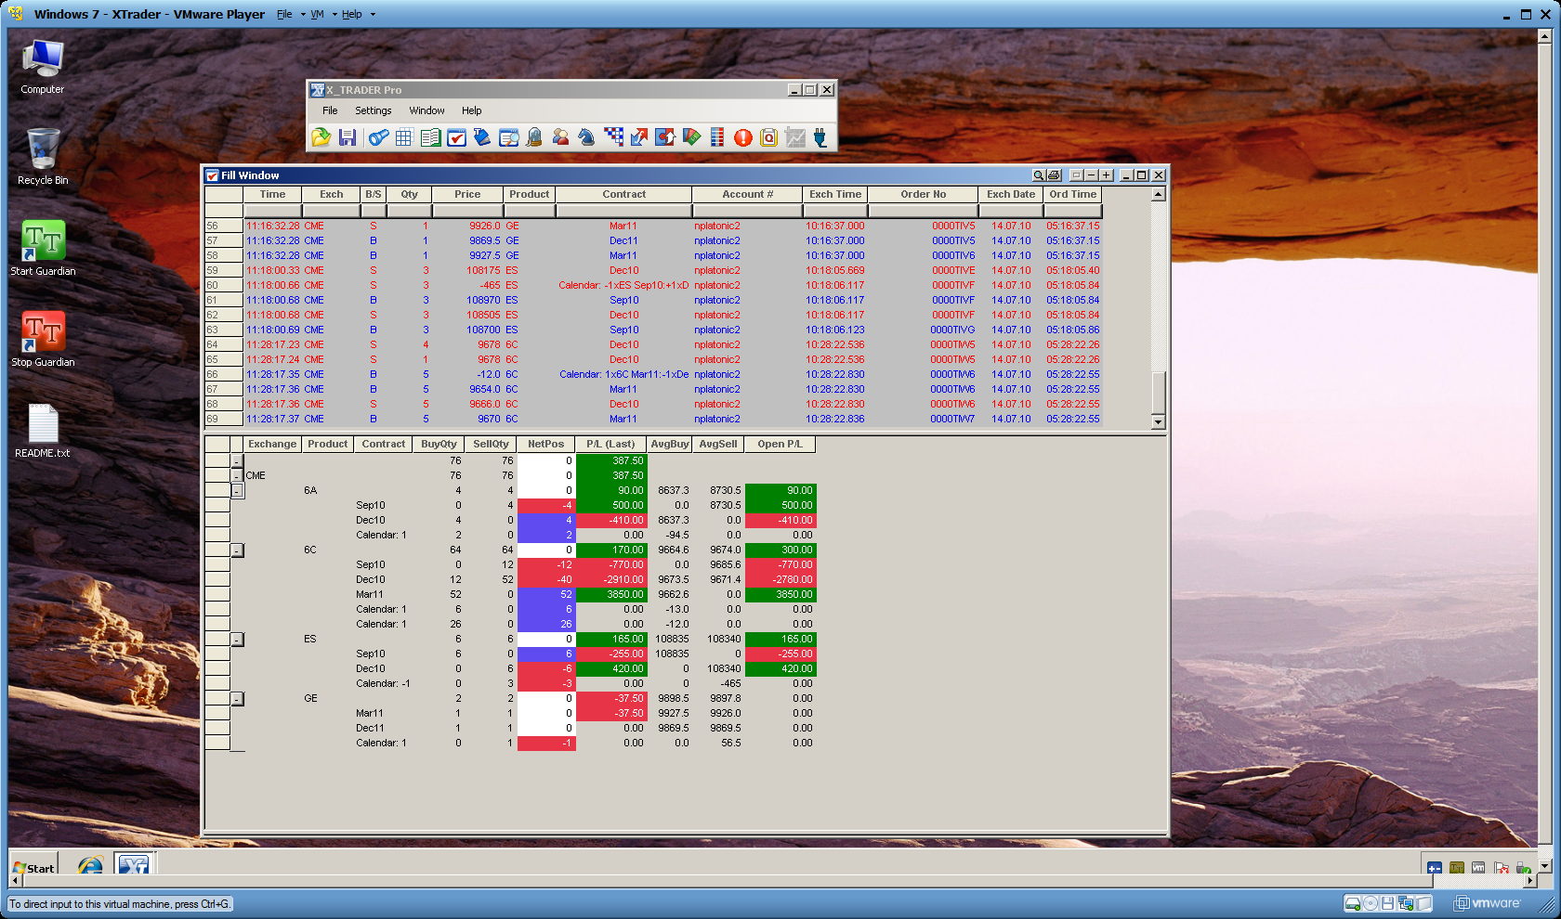
Application should assume information from Side Tag 54
Fixed

Slide 5
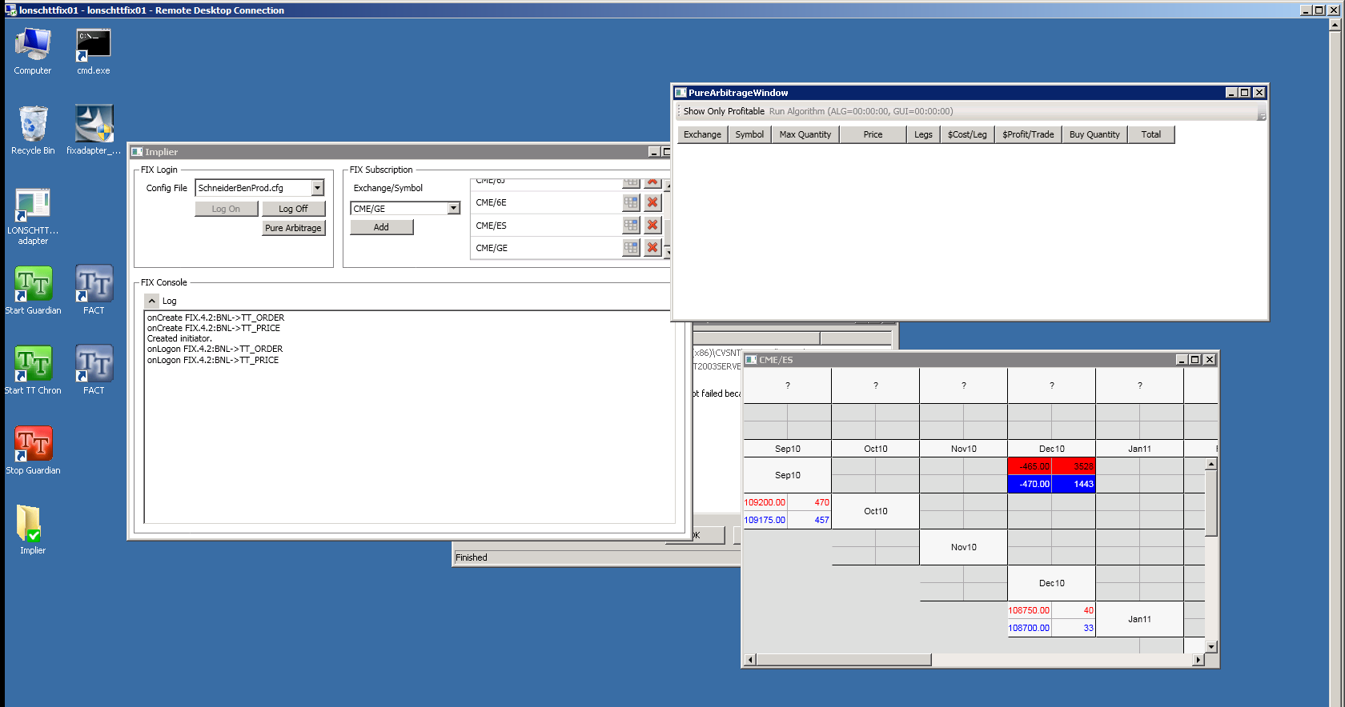
It looks like there are trades involving the September and December outrights and spreads. Why aren’t these showing in the arbitrage window?
See next slide

Slide 6
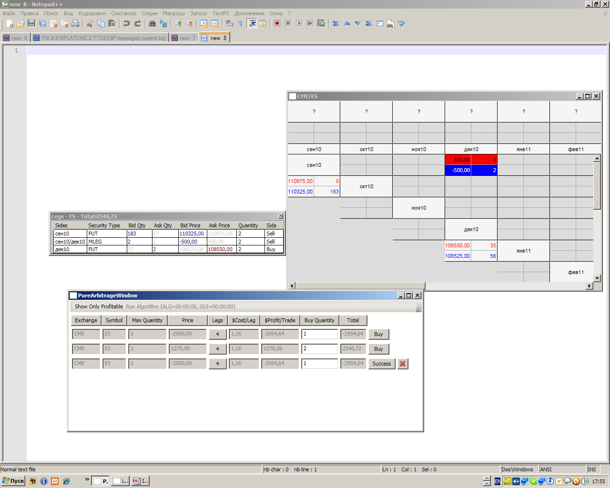

Slide 7
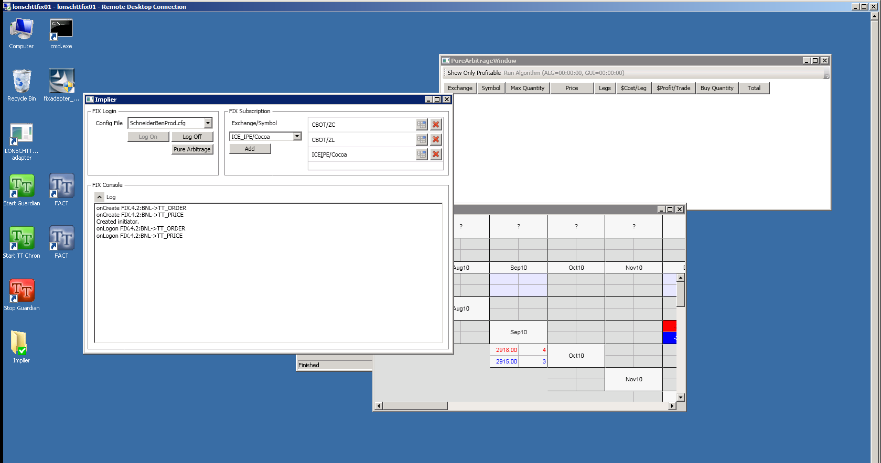
Exchange/Symbol is ICE_IPE/Cocoa, but shown as ICEIPE/Cocoa.
Fixed

